Slide 1

INSTACHAT (MINOR-1 PROJECT)
Presented By:
DHRUV SINGH WADHAWAN (9919102075) – E2
FARDEEN KHAN (9919102021) – E2
SIDDHANT SINGH (9919102073) – E2
Under the Supervision of :
Dr. Vimal Kumar Mishra
DEPARTMENT OF ELECTRONICS AND COMMUNICATION ENGINEERING
JAYPEE INSTITUTE OF INFORMATION TECHNOLOGY, NOIDA (U.P.)

Slide 2
CONTENTS
Introduction
Problem Statement
Literature Survey
Methodology
Tools and Technologies Used
Front-End Development
Back-End Development
Architecture
Chat App Code ( Developed )
Rough Design of the features.
Limitations
Conclusion and Future Scope
References

Slide 3
INTRODUCTION
Messaging is a method of using technology to bring people and ideas together despite of geographical barriers. The technology has been available for years but the acceptance it was quite recent.
Our Project will have a chat server. It is made up of applications, first one is the client server application, which runs on the user’s PC and server application that will be deployed at our home on an individual.
To start chatting client should get connected to a server where they are able to practice public type of chatting where message is being broadcasted to all connected users.

Slide 4
INTRODUCTION (contd.)
The most common languages used for Web programming are XML, HTML, JavaScript, CSS and PHP.
Web programming is different from just programming, which requires interdisciplinary knowledge on the application area, client and server scripting, and database technology.
To improve user experience and related functionalities on the client side, JavaScript is usually used. It is an excellent client-side platform for designing and implementing Web applications.
It also needs to ensure there are enough plugins to enrich user experience in a graphic user interface, including security measures.
HTML5 and CSS3 supports most of the client-side functionality provided by other application frameworks.

Slide 5
PROBLEM STATEMENT
It is estimated that more than a million messages are exchanged between a business and a consumer or between few individuals through instant messaging apps. The texts are more user-friendly and directed towards the user base.
InstaChat is highly suitable for business and it is much responsive with real time messaging experience.
InstaChat allows you to get on with other things and yet be in touch real time with connected friends and colleagues.
InstaChat app allows you to use its free service with no disturbing advertisements and pop ups.

Slide 6
LITERATURE SURVEY
S.no | Article Name | Features | Drawbacks
1. | Android Based Instant Messaging Application Using Firebase[6]. | It helps in implementing the backend technology of the application and storing the real-time database. | Firebase doesn’t provide any migration tools to transfer your data to another platform.
2. | Comprehensive Analysis of React-Redux Development Framework[4]. | It is used in implementing framework to create a hybrid application capable of provisioning solutions. | No encapsulation. Any component can access the data which can cause security issues.
3. | Multi-User Chat Application[5]. | It also enables the feature of sharing resources like files, images, videos, etc. | File transfer is not available through url. Video Transfer is also not available.
4. | Developing an End-to-End Secure Chat Application[7]. | The aim of the paper is to propose chat application that provides End-to-End security that let safely exchange private information with each other without worrying about data. | Due to encryption and security issues , the chat history is not saved and is not end-to-end encrypted.

Slide 7
METHODOLOGY
This project is developed using web programming and it’s components like HTML , CSS , JAVASCRIPT, REACTJS and FIREBASE. The project is developed to overcome the barrier between the modern form of communication.
methods used to developed the application:
HTML: It defines the content of the chat application.
CSS: It specifies the layout of the chat application. The styling of the chat application like you see in Login and Register page is done using CSS.
JavaScript: It is used to program the behavior of the Chat application. This is used for authentication purposes in the chat application.
React Js: It is used to build user interface and testing purposes of the chat application. The structure of the chat application is build on this component.
Firebase: It is used to store real-time database of the chat application. This is used for the backend purpose in the chat application.

Slide 8
TOOLS AND TECHNOLOGIES USED
TOOLS USED:
HTML/CSS
JAVASCRIPT
EXPRESS JS
REACT JS
FIREBASE
MATERIAL-UI
SEMANTIC UI
FIRESTONE DB
TECHNOLOGIES USED:
FRONTEND
BACKEND
SERVER-SIDE ARCHITECHTURE
CLIENT-SIDE ARCHITECHTURE

Slide 9
FRONTEND DEVELOPMENT
Front end development is programming which focuses on the visual elements of a website or app that a user will interact with (the client side).
HTML-CSS is used as a skeleton to our webapp in which JAVASCRIPT plays a vital role and helps by building a bridge between two ends hence connecting Frontend and Backend which further contains libraries like REACT JS which uses Components functions and these functions are further used for designing our website.
Apart from this, we also used MATERIAL UI, it contains some designing components by default which are also used separately in the Chat section of our Webapp.

Slide 10
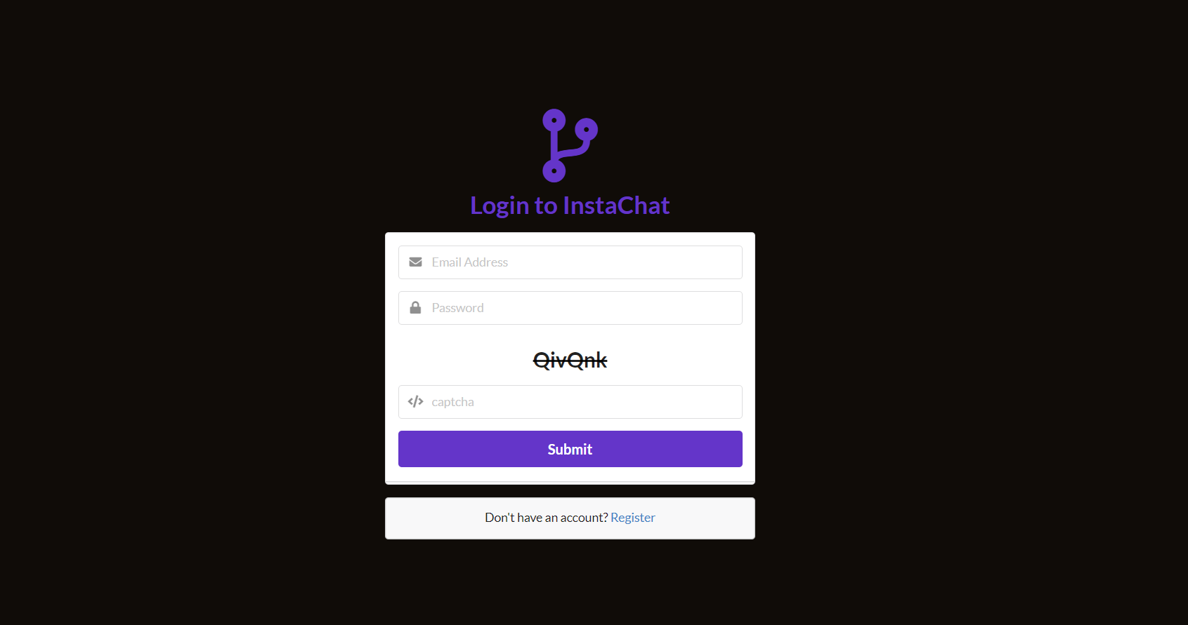
FRONTEND WORK
Fig.1 Login page

Slide 11
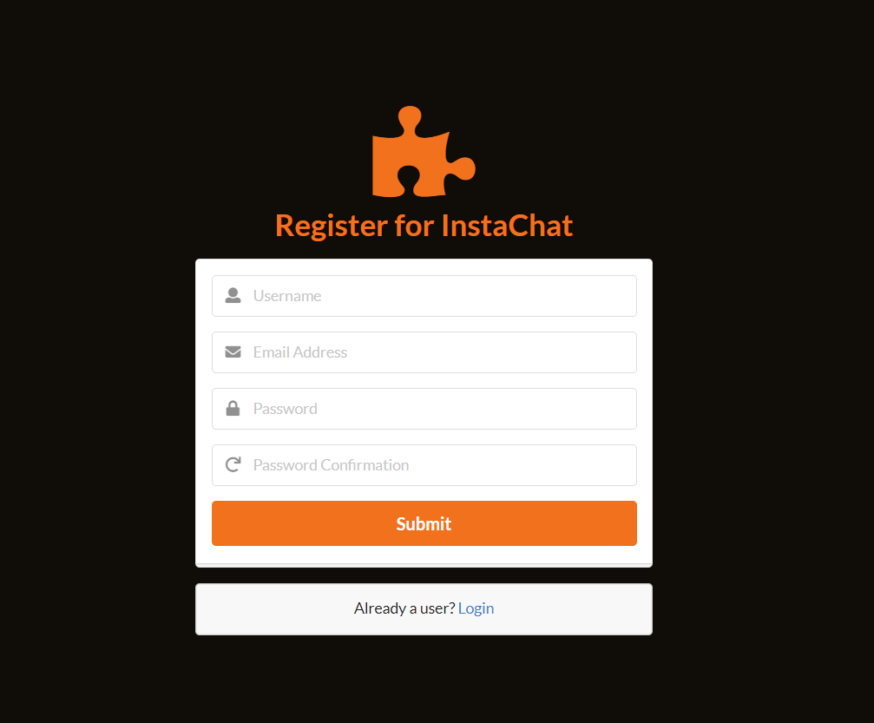
Fig.2 Register Page

Slide 12
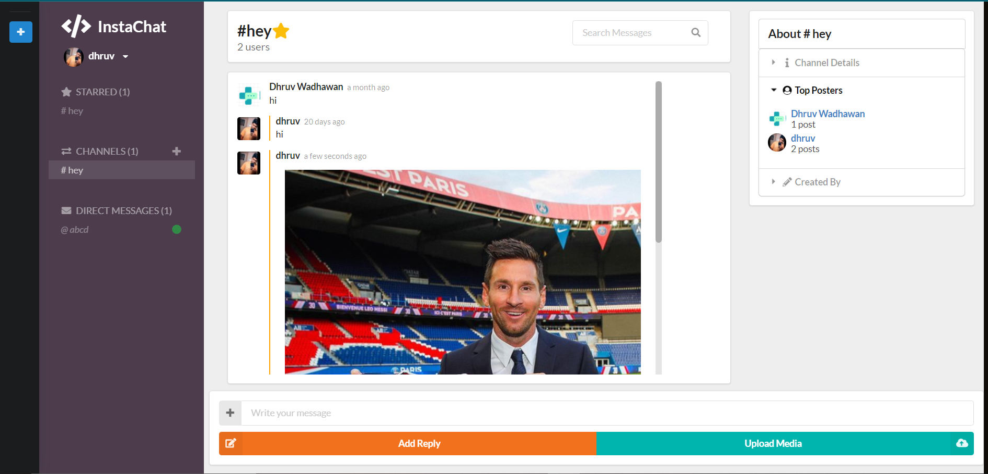
Fig.3 Channel view

Slide 13
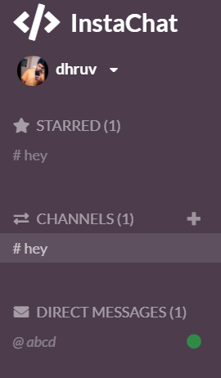
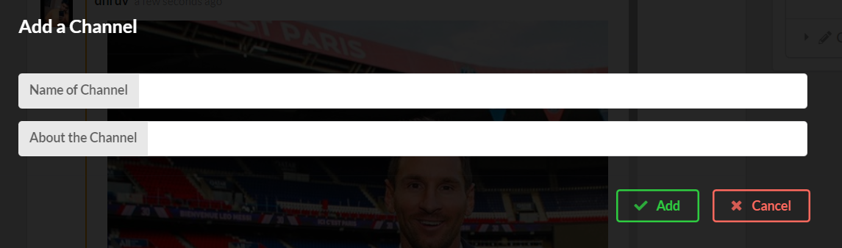
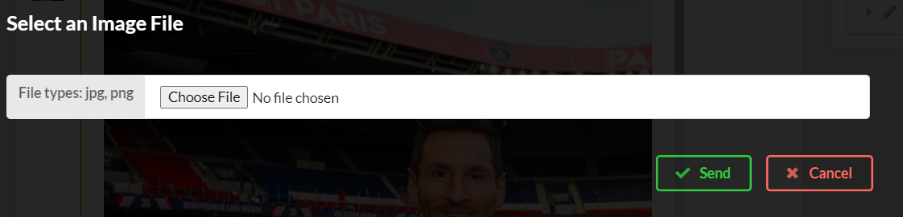
Fig.4 Side panel view and the features in it.

Slide 14
BACKEND DEVELOPMENT
FIREBASE:-
Firebase is a platform developed by Google for creating mobile and web applications.
It was originally an independent company founded in 2011. In 2014, Google acquired the platform and it is now their flagship offering for app development.
Firebase provides tools for tracking analytics, reporting and fixing app crashes, creating, hosting , marketing and product experiment.
The Firebase Realtime Database is a cloud-hosted NoSQL database that lets you store and sync data between your users in real-time.
Firebase is made up of complementary features that you can mix-and-match to fit your needs, with Google Analytics for Firebase at the core.

Slide 15
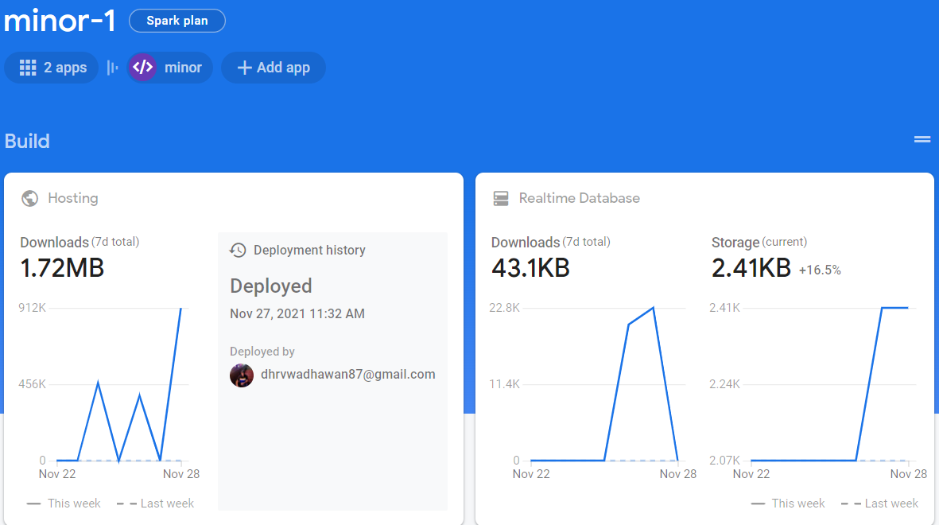
BACKEND DEVELOPMENT
Fig.5 Firebase home page

Slide 16

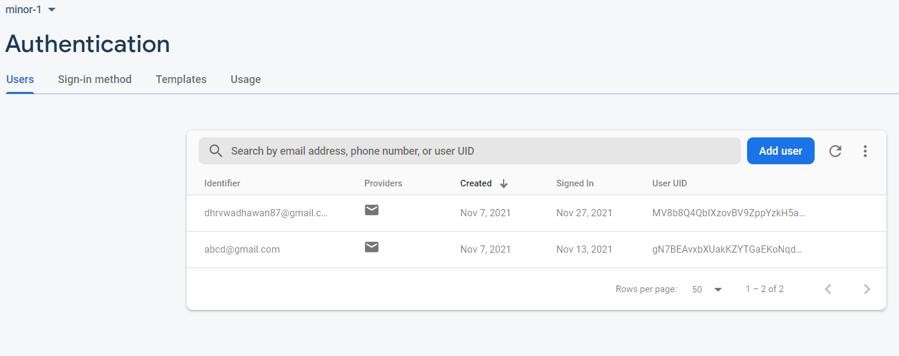
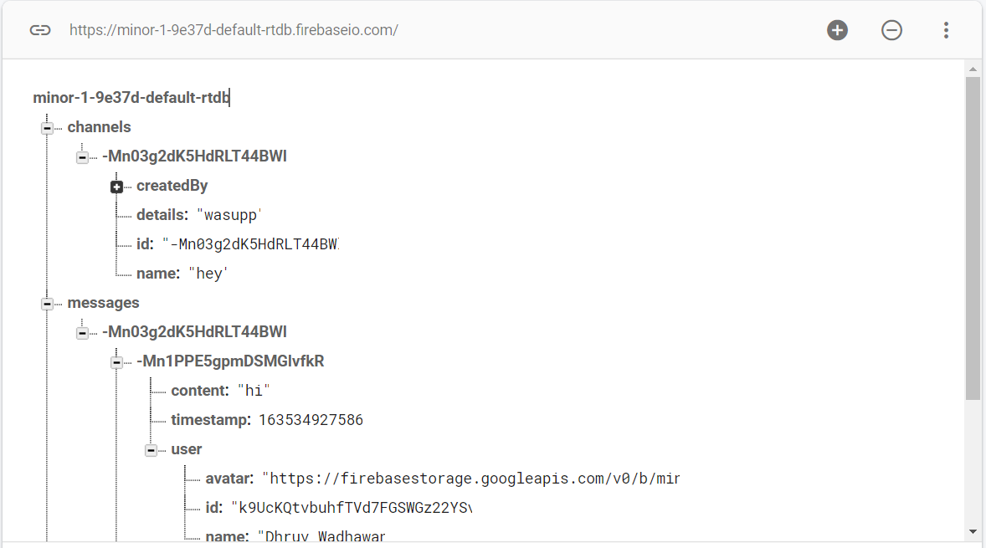



Fig. 6 Authentication in firebase

Slide 17
ARCHITECHTURE
Server Side Architecture :
A server is a specially equipped computer connected to the internet that allows users with chat clients to converse with one another via typed messages in real time.
The server responds to HTTP calls by returning HTML.
Typically, a server is a computer program, such as a web server, that runs on a remote server, reachable from a user's local computer or workstation.
Client Side Architecture :
A client is a software program that allows users to connect to chat servers and communicate with other users via a chat room.
The browser first requests the HTML from the server. Contrary to server side architecture, the HTML does not contain any data
Client-side web development involves interactivity and displaying data, server-side is about working behind the scenes to manage data.

Slide 18
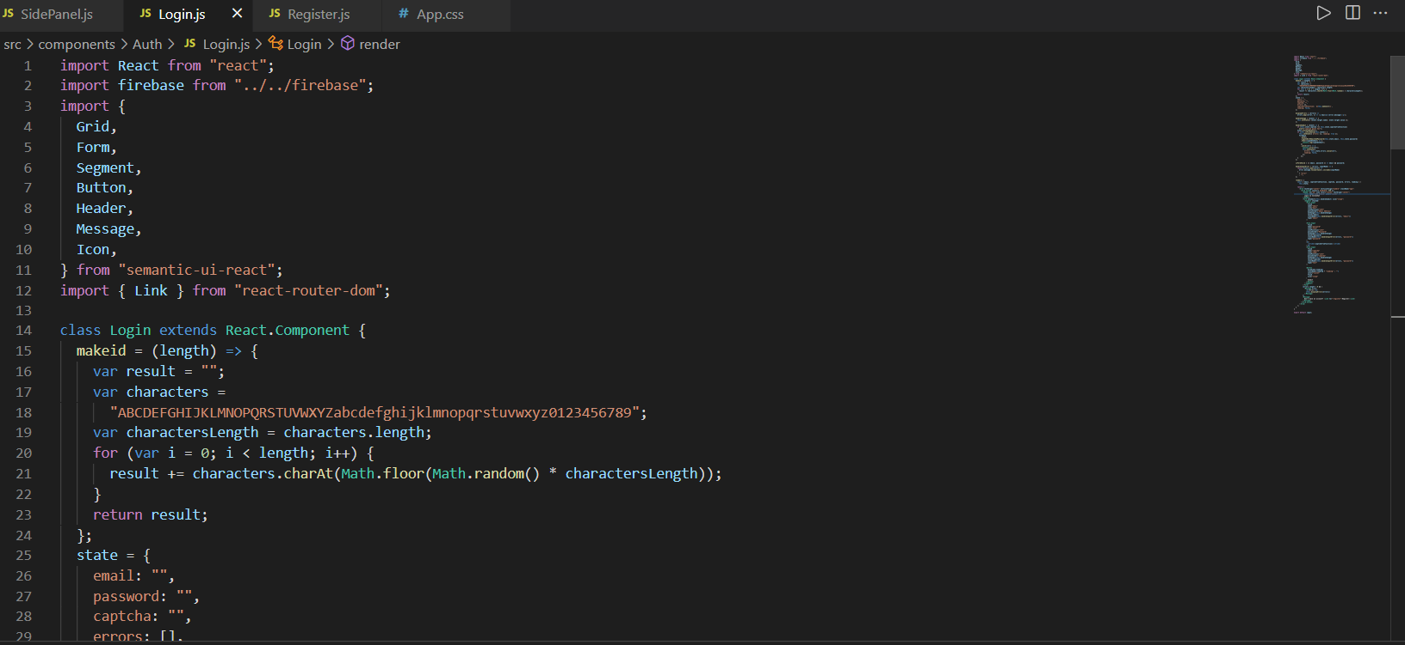
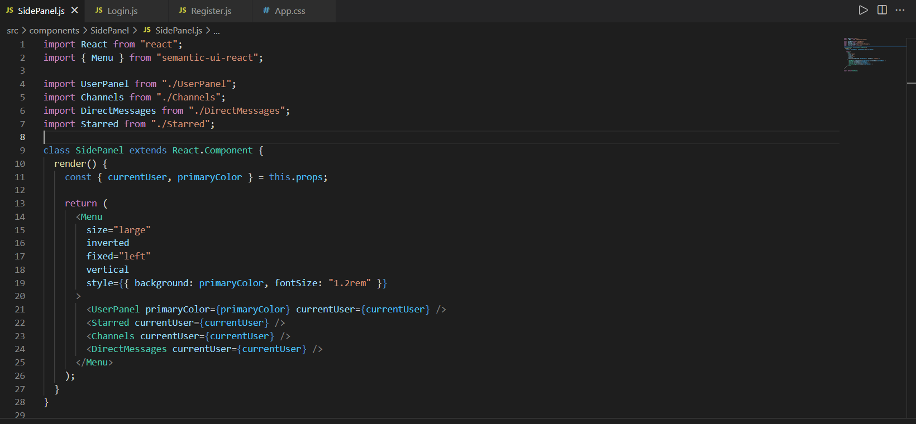
CHAT APP CODE (DEVELOPED)
Fig.7 Developed Code-1

Slide 19
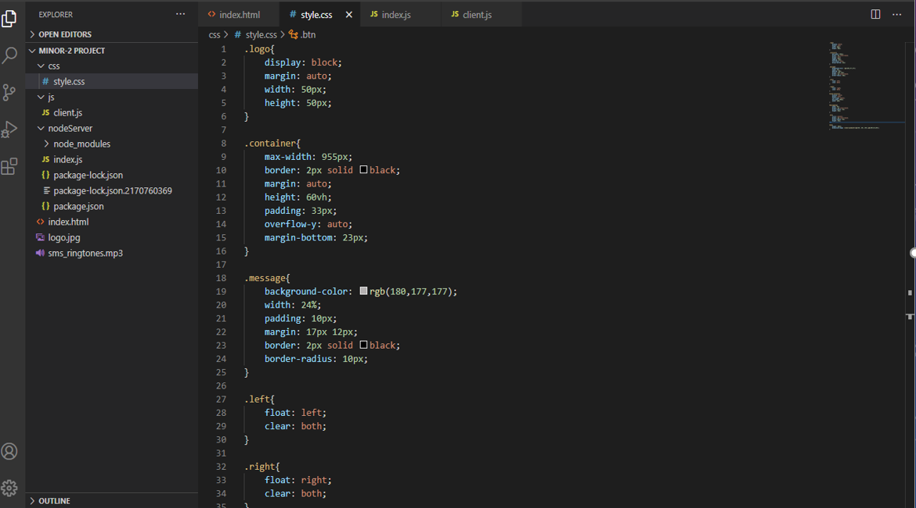
Fig.8 Developed Code-2

Slide 20

ROUGH DESIGN OF THE FEATURES
Login
Member List
Chat Box
File Transfer
USER
Messages
Fig.9 Features included in the application

Slide 21


Chat Server aggregate message from all user and sent to their respect receiver or clients.
Chat Client’s send user’s message to server.
Other User’s client display message from chat server.
Fig.10 How the architecture works in the application

Slide 22
LIMITATIONS
It requires access to internet.
The file has to be uploaded manually, insertion through URL not available.
Due to security/encryption reasons, we aren’t allowed to save the chat history
It shows lists of all the members who have logged in the app regardless of wether he is your contact or not.
There is no feature of Voice recording transfer and Video transfer in chat.

Slide 23
CONCLUSION and FUTURE SCOPE
There is always a room for improvements in any software package, however good and efficient it may be done. But the most important thing should be flexible to accept further modification right now we are just dealing with text communication. In future this software may be extended to include features such as:
File transfer: This will enable the user to send files of different formats to others via the chat application.
Text transfer: This will allow the user to chat with the multiple users.
Chat Groups: This will help the user to convey messages to huge number of other users. It is also for sharing useful information at the times of pandemics and other natural calamities ( like the one we are dealing with now is COVID-19).
It also shows who are the top posters in the channels.

Slide 24
REFERENCES
https://reactjs.org/docs/getting-started.html
https://react.semantic-ui.com/ https://www.w3schools.com/html/html5_semantic_elements.asp
https://react-jsonschema-form.readthedocs.io/en/latest/apireference/themes/semantic-ui/uiSchema/
Sharvan G V, Prof. Anitha Sandeep, "Comprehensive Analysis of React-Redux Development Framework", International Journal of Creative Research Thoughts (IJCRT), Volume 8, issue 4, April 2020
R. Gayathri, C. Kalieswari , “Multi-User Chat Application”International Journal of Engineering and Advanced Technology (IJEAT) ISSN: 2249 – 8958 (Online), Volume-9 Issue-5, June 2020
Sai Spandhana Reddy Emmadi, Sirisha Potluri , “Android Based Instant Messaging Application Using Firebase” , International Journal of Recent Technology and Engineering (IJRTE) ISSN: 2277-3878, Volume-7 Issue-5S2, January 2019.
Noor Sabah, Jamal Mohammad and B.N. Dhanoon , “Developing an End-to-End Secure Chat Application”, International Journal of Computer Science & Engineering Survey 7(3):1-21DOI:10.5129/ijcses.2016.7503, April 2020

Slide 25
THANK YOU TO ALL THE PANELISTS.

